Slide 1
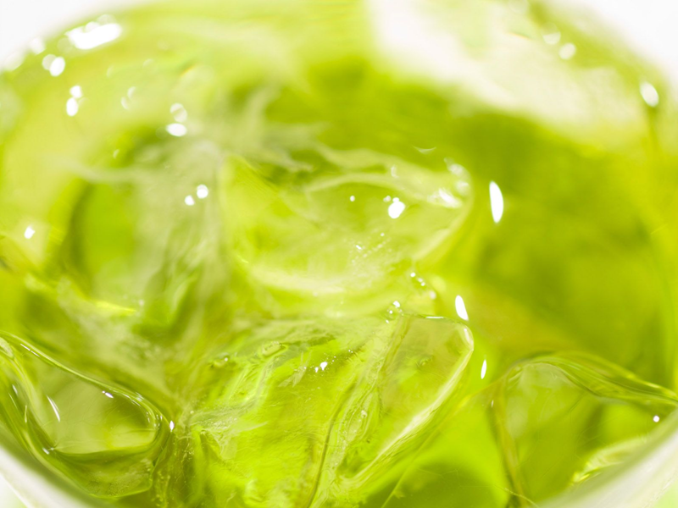


Practical English

Slide 2
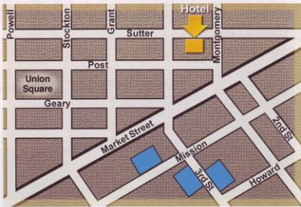
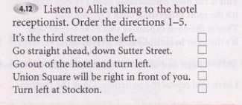

4
2
1
5
3

Slide 3
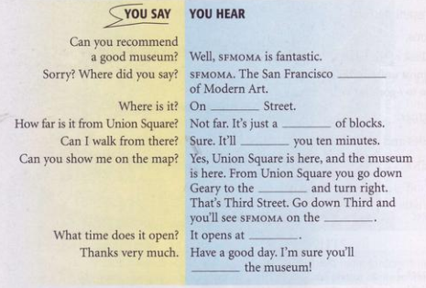

b Complete the YOU HEAR phrases. Listen and check.
a Cover the dialogue and listen.
- Where does Allie want to go?
- How is she going to get there?
She wants to go to the museum of modern art
museum
third
She is going to walk there
couple
take
end
left
11
love

Slide 4
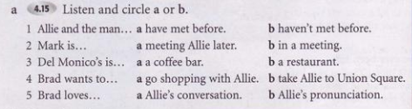
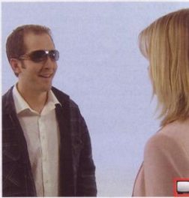
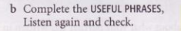
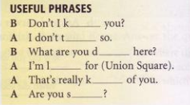
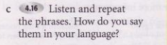
now
hink
oing
ookng
ind
ure

Slide 5
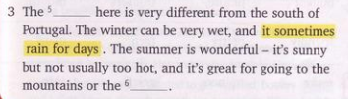
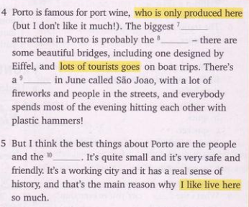
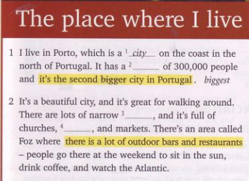

Slide 6
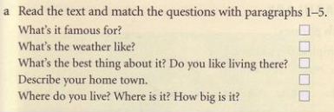
4
3
5
2
1

Slide 7
We use superlative adjectives to compare three or more people,things, etc.
USES:
Ex: He is the most intelligent student in the class.
We often use superlative adjectives with the present perfect.
Ex: Russia is the coldest place we’re ever been to.
It’s the most beautiful church I’ve ever seen.

Slide 8
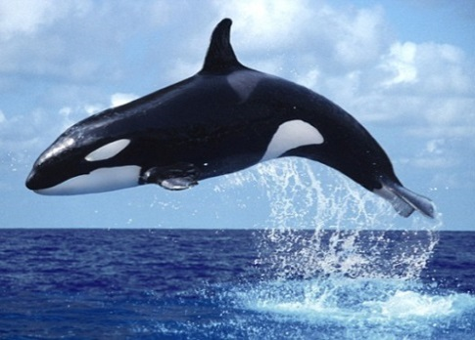
Short adjectives
cold
big
cheap
slow
heavy
coldest
biggest
cheapest
slowest
heaviest
“the” +
The whale is the biggest animal in the ocean
S + tobe + the + short adj + est

Slide 9
Long adjectives
interesting
intelligent
dangerous
expensive
beautiful
most interesting
most intelligent
most dangerous
most expensive
most beautiful
“the ” +
She is the most beautiful girl in the world.
S + tobe + the most + long adj

Slide 10
If a short adjective ends in one vowel + consonant we (a,e,i,o,u) (b,c,d,f,g,h,j,k,l,m...) double the consanant and add -est (except adjs ending “w”)
NOTES:
If a short adjective ends in e, we add -st
wide - widest large - largest
big - biggest
hot - hottest
thin - thinnest
fat - fattest
new - newest
slow - slowest
low - lowest

Slide 11
If an adjective (one or two sylabbles) ends with a consonant + y, we change y to -i and add -est.
shy - shiest
dry - driest
ugly - ugliest
happy - happiest
funny - funniest
easy - easiest
If a short adjective ends with a vowel + y, we add -est.
grey - greyest
gay - gayest

Slide 12
Irregular words change;
good = the best
bad = the worst /wɜ:st/
many/much = the most
little = the least
far = the farthest/furthest(tg+kc)
old = the oldest/eldest (cấp bậc)

Slide 13
IMPORTANT NOTE:
With some 2-syllable adjectives end in “le, er, ow, et”, we can use "-est" OR “most":
quiet → the quietest/most quiet clever → the cleverest/most clever narrow → the narrowest/most narrow simple → the simplest/most simple
gentle → the gentlest/ most gentle

Slide 14
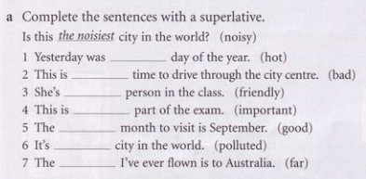
Exercises 4D
the hottest
the worst
the friendlest
the most important
the best
the most polluted
the furthest

Slide 15
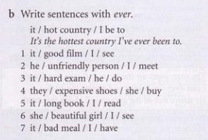
It’s the best film I’ve ever seen.
He’s the most unfriendly person I’ve ever meet.
It’s the hardest exam he’ve ever done.
They’re the most expensive shoes she’s ever bought.
It’s the longest book I’ve ever read.
She’s the most most beautiful girl I’ve ever seen.
It’s the worst meal I’ve ever had.

Slide 16
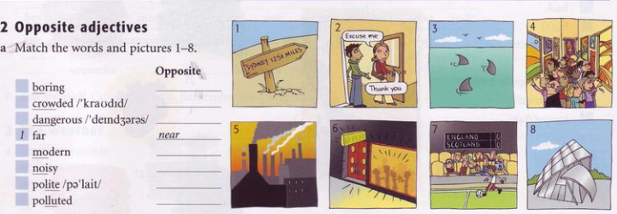
a What are the opposites of these adjectives?
friendly
rude
noisy
boring
unfriendly
polite
quiet
interesting

Slide 17
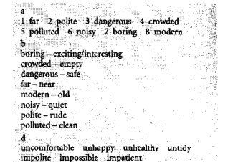
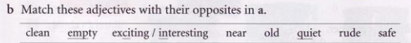
7
4
3
8
6
2
5

Slide 18
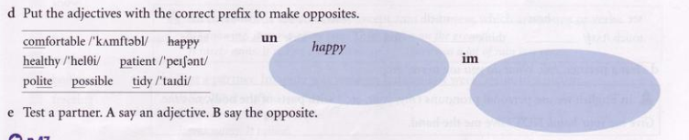

Slide 20
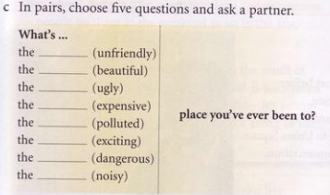

Slide 21
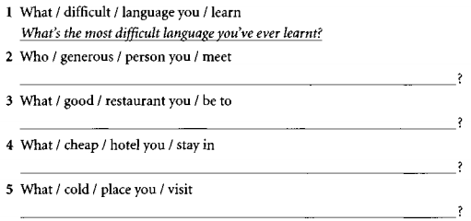
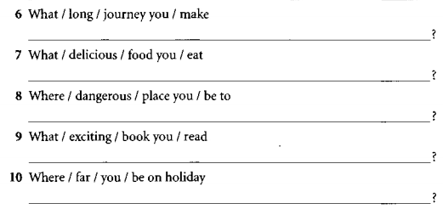
Exercises

Slide 23
